Slide 1
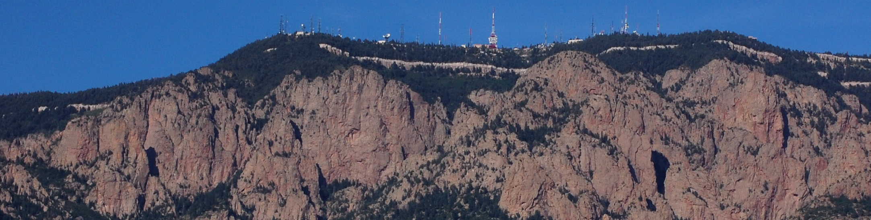
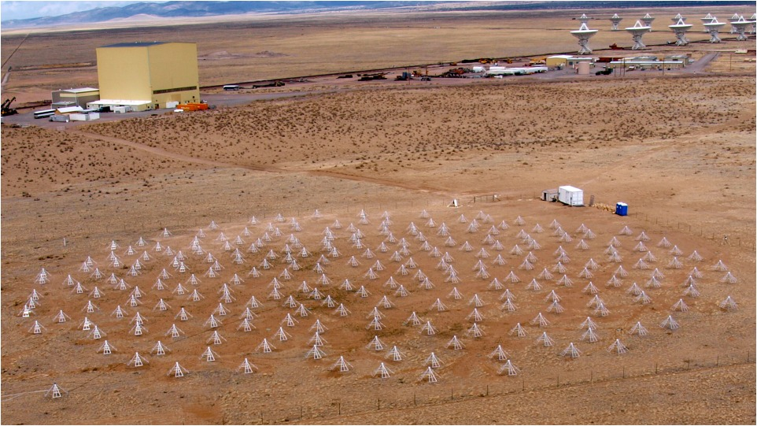
Passive Radar with LWA1
J. Helmboldt (NRL)
LWA Users Meeting, Albuquerque, NM
July 27, 2012

Slide 2
Introduction
Passive radar is a technique that uses existing transmitters (e.g., FM radio broadcasts) to detect and determine range to reflections from objects, terrain, and/or ionosphere
Has been used successfully to study coherent scattering from ionospheric irregularities associated with turbulence
Past work used small (3-element) array: The sensitivity and all-sky capability of LWA1 provide potential to greatly expand upon understanding of ionospheric irregularities using passive radar

Slide 3
Background – Ionospheric Echoes
Radar-based studies of the ionosphere constitute a rich field of study
HF and VHF signals can be reflected/refracted by structures if ν = ν_{pe} sec(θ) ≈ 8.98 sec(θ)√n_{e} kHz, where θ is signal’s angle of incidence
HF and VHF signals can also be coherently back-scattered by irregularities with λ_{irr} ≈ λ⁄2
HF, VHF, and UHF signals are incoherently scattered by ions and free electrons

Slide 4
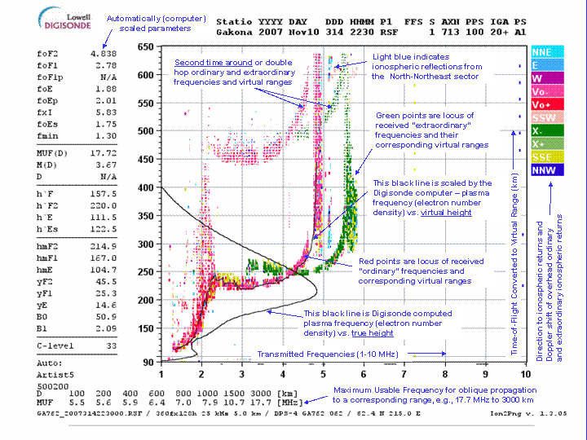
Reflection
Reflections frequently used by instruments like ionosondes to probe the density structure of the ionosphere
Example of “ionogram,” main product generated by ionosonde radar frequency sweeps

Slide 5
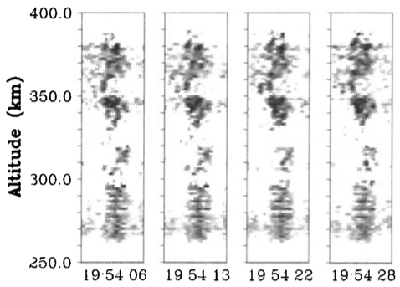
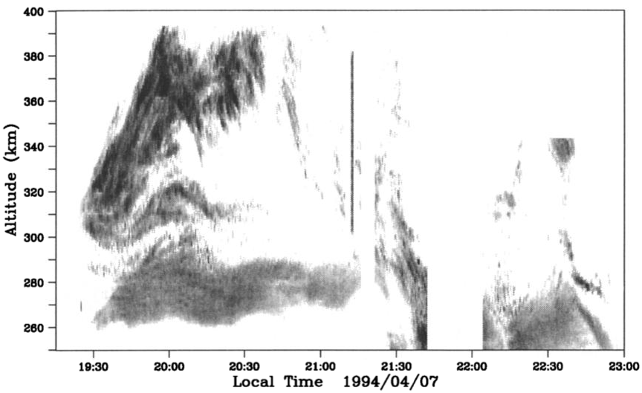
Coherent Scattering
Coherent scattering used to study evolution of irregularities using radar arrays
Also have ability to image irregularities with phased HF/VHF arrays (e.g., Jicamarca)
From Hysell (1996)

Slide 6
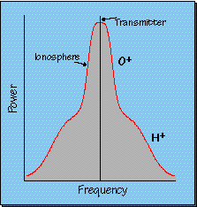
Incoherent Scattering
Ions and free electrons incoherently scatter signals up to UHF regime
Returned signal is “Doppler broadened”; the profile contains information about temperature of different ions and the free electrons and the wind speed

Slide 7
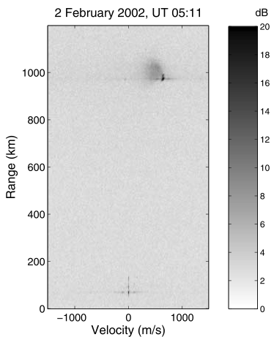
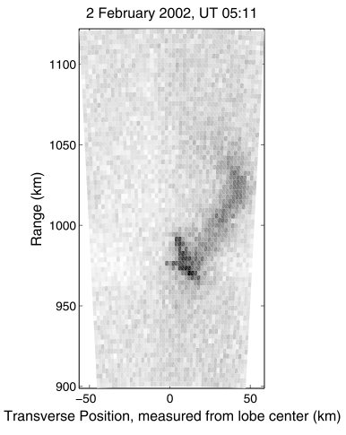
Passive Radar
Uses a measurement of the original signal (usually with reference antenna) as a matched filter to pick out echoes at a particular delay/range; ionospheric echoes typically Doppler shifted as well
Has been used to detect/study coherent scattering from subauroral ionospheric turbulence using FM radio broadcasts with a 3-element array and a reference antenna
ionospheric echoes
reflections off mountains
from Meyer and Sahr (2004)
imaging resolution hampered by size of array

Slide 8
Passive Radar Prospects for LWA1
LWA1 has a unique combination of sensitivity and all-sky capability
Has potential for passive radar with several sources of “RFI”
Have preliminary results from TBW data for FM radio and analog TV broadcasts
For nearby FM station (KUNM), can isolate transmitter signal using beam-forming
KUNM; in Sandia Mountains near Albuquerque

Slide 9
LWA1 and FM Radio
Used beam-formed KUNM signal as matched filter and found several echoes at ranges < 50 km ➔ reflections off nearby terrain
There are smaller peaks at higher ranges, but imaging shows they are all on the horizon ➔ “sidelobes” from terrain echoes
So far, no ionospheric echoes detected with KUNM signal
match-filtered power versus range
transmitter auto-correlation subtracted

Slide 10
LWA1 and FM Radio (cont.)
LWA1 all-sky capability allows one to produce 3-D map of reflected echoes
Used maps within each range bin to isolate 3σ detections; used locations on maps to produce map of mean reflected power shown here with relief map

Slide 11
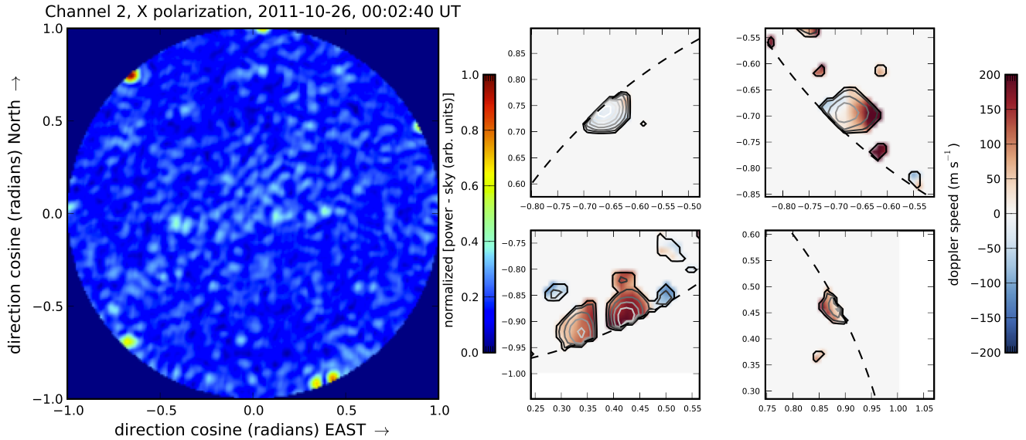
LWA1 and Analog TV
LWA1 routinely detects signals from analog TV stations
Since US (mostly) switched to digital format, most of these are ionospheric reflections from distant stations in Mexico
Fainter ionospheric echoes easier to detect without transmitter and terrain echoes, but no match-filter for ranging
All-sky imaging of “channel 2” from TBW shows several scatterers (frequency too high for reflection); confined to low elevations because of increased path-length)
Video carrier narrow-band ➔ can get Doppler speeds

Slide 12
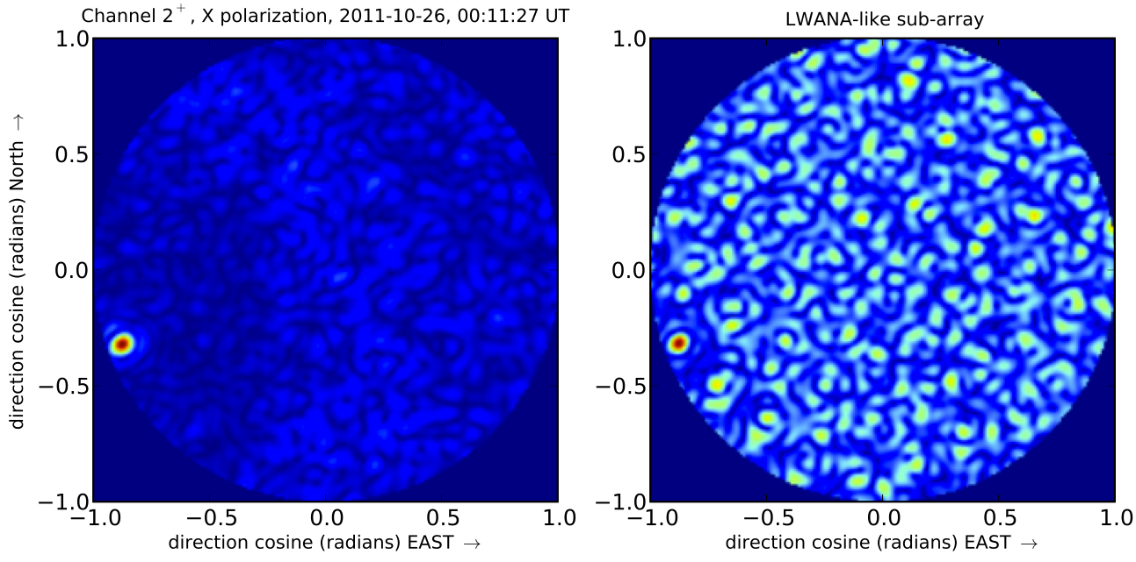
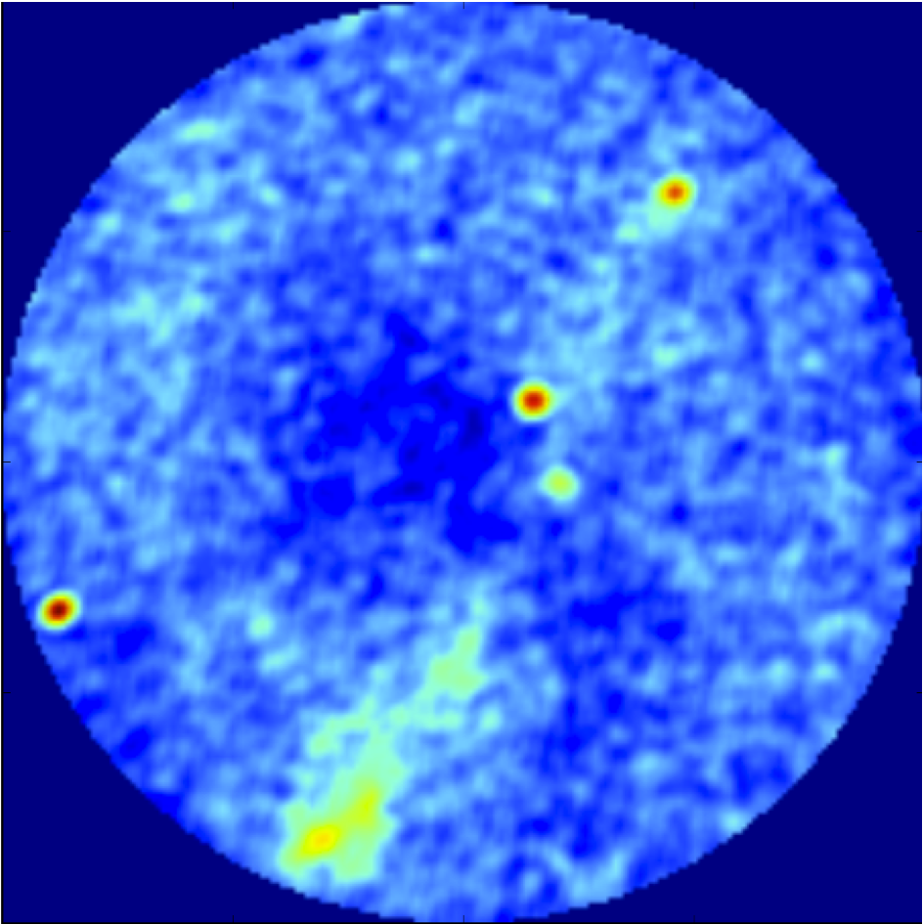
LWA1 and Analog TV (cont.)
With LWANA, have potential alternative method for measuring distances to echoes using parallax
Cas A
Cyg A
echo
“continuum” image shows clear detection of cosmic sources that can be used as references for parallax measurements
echo
GC

Slide 13
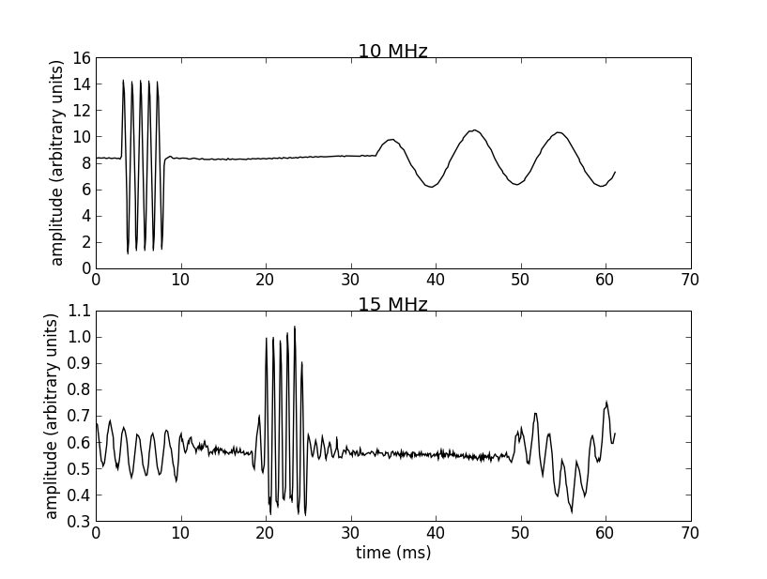
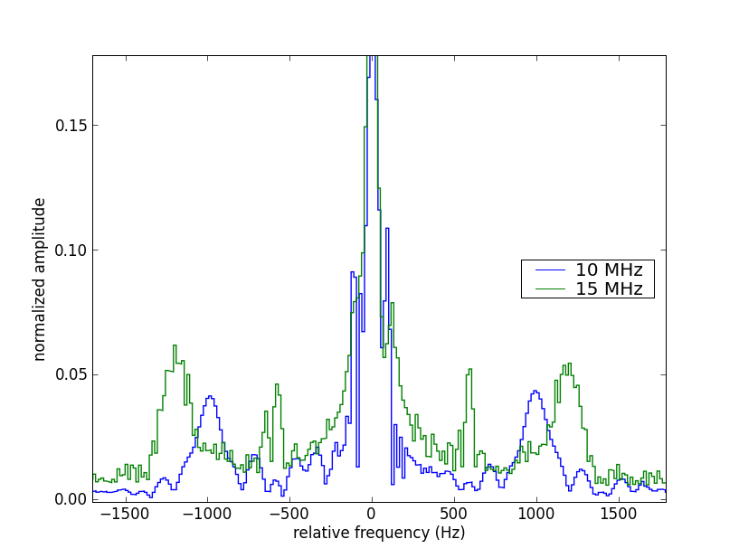
LWA1 and Time Broadcasts
Stations WWV in Fort Collins, CO and WWVH in Hawaii continually broadcast the time at 2.5, 5, 10, 15 and 20 MHz
Routinely see 10 and 15 MHz signal in TBW data; 20 MHz is weaker and overpowered by other transmitters
“On-the-second,” 5-ms pulses can be used for ranging
Directly detect WWV transmitter at 10 MHz; pulse is modulated at 1000 Hz
Sometimes detect strong echo from WWVH, especially at 15 MHz; pulse is modulated at 1200 Hz
isolate these spectral regions and FFT to map power as function of range

Slide 14
LWA1 and Time Broadcasts (cont.)
25-minute sequence from successive TBW captures of all-sky/range maps:
t = 00 min.

Slide 15
LWA1 and Time Broadcasts (cont.)
20-minute sequence from successive TBW captures of all-sky/range maps
t = 05 min.

Slide 16
LWA1 and Time Broadcasts (cont.)
25-minute sequence from successive TBW captures of all-sky/range maps
t = 10 min.

Slide 17
LWA1 and Time Broadcasts (cont.)
25-minute sequence from successive TBW captures of all-sky/range maps
t = 15 min.

Slide 18
LWA1 and Time Broadcasts (cont.)
25-minute sequence from successive TBW captures of all-sky/range maps
t = 20 min.

Slide 19
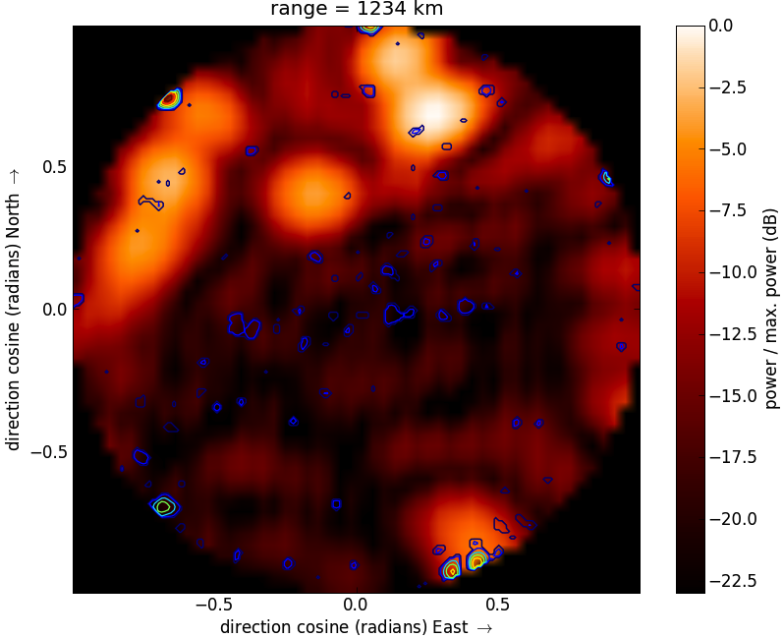
TV and Time Broadcasts
In some cases, see scatterers at both 15 and 55.25 MHz
Can get range from 15 MHz data and size constraints and Doppler speeds from 55.25 MHz data
Altitude of about 100 km; Doppler speeds between 100 and 200 m s⁻¹; sizes < 45 km

Slide 20
Summary and Future Plans
Using TBW data, I have just begun to explore the capabilities of LWA1 to investigate the ionosphere via passive radar
I will continue analyzing available TBW data using FM-radio-based passive radar to search for strong ionospheric scattering events which may be imaged in three-dimensions
I have proposed for a campaign of TBN observations at 55.25 MHz with LWA1 and simultaneously with LWANA to explore the nature of the ionospheric “clouds” scattering the detected channel 2 analog TV signals, possibly including range information derived via parallax for strong, isolated echoes
Collaborating with Jake Hartman to get TBN observations of the time signals at 10 and 15 MHz with PASI running; already have 20-minutes of data

Slide 21
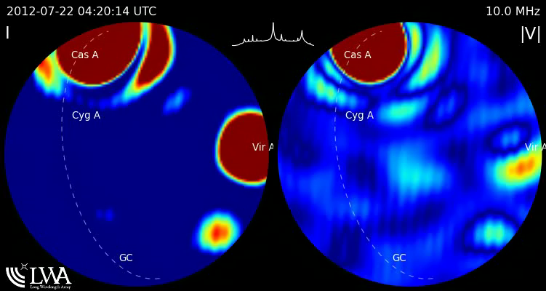
PASI Movie of Time Signals

