Slide 1
Pulsars with LWA1
Paul S. Ray and Sean Cutchin
Naval Research Laboratory
2012 July 26
LWA1 pulsar discussions:
lwa-pulsar@phys.utb.edu
Contact me or Kevin Stovall if you want to join!
Basic research in radio astronomy at NRL is supported by NRL/ONR

Slide 2

Pulsars and Fast Transients With LWA1: Capabilities
Pulsars and Fast Transients are perfect “single dish” science
LWA1 is comparable to a 100 m dish at 38 MHz
Broad bandwidth observations are possible
Wide field of view for rapid survey speed
Raw voltage data recorded so coherent dedispersion and other techniques can be applied in post-processing
Dispersion is a powerful discriminator against RFI
Data time tagged to GPS for precise timing
Similar sensitivity to LOFAR for pulsar work, but
  Better sky coverage (site is 20° further south)
  Larger bandwidth (78 MHz vs 48 MHz)
  Better RFI environment
  LWA1 records raw voltages, allowing more flexible processing

Slide 3
LWA1 Can Address A Wide Range of Pulsar Science Topics
Profile evolution (at high time resolution) vs. frequency
Polarization studies
Subpulse structure (nulling and drifting subpulses)
Spectral turnovers
Searches for steep-spectrum pulsars
ISM, Solar Corona, and Ionosphere effects
  Scattering (including variable scattering)
  “Super”-dispersion
  Faraday rotation
Single pulse studies
  Crab Giant Pulses, Anomalously Intense Pulses
  RRATs
  Single dispersed pulses (PBHs and other exotica)
Emission
Mechanisms
New Sources
Propagation Effects
Transient and Exotic
Sources
See Walid’s talk

Slide 4
LWA1 Pulsar Detections
Several pulsars detected very strongly (see plots on next slides)
Why the non-detections?
B0942-14: Pretty far off zenith and pointing errors may have contributed
B1929+10: Unknown? Would be great as a polarization cal!
J1012+5307: MSP so DM smearing reduces detectability. Coherent dedispersion may be the answer

Slide 5
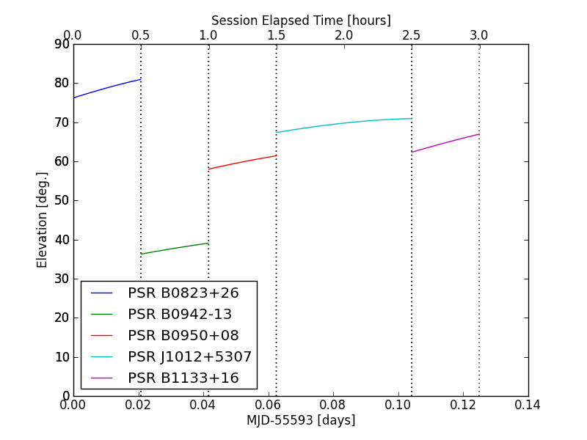
Elevation/Pointing?
Undetected MSP
Undetected

Slide 6
PSR B1133+16 (580 mJy at 74 MHz)

Slide 8
PSR B0950+08
Note poor DM.
Improved with Tempo2.
Accuracy few × 10⁻⁴ pc/cm³

Slide 9
PSR B1919+21
1-min burst?

Slide 10
RFI Examples
Generally benign RFI environment
  ~1% of data flagged as bad
Something strange going on, however
  Similar RFI showing up in both tunings
  Looks like internal issue in DRX???
  Or, crazy software problem??

Slide 11
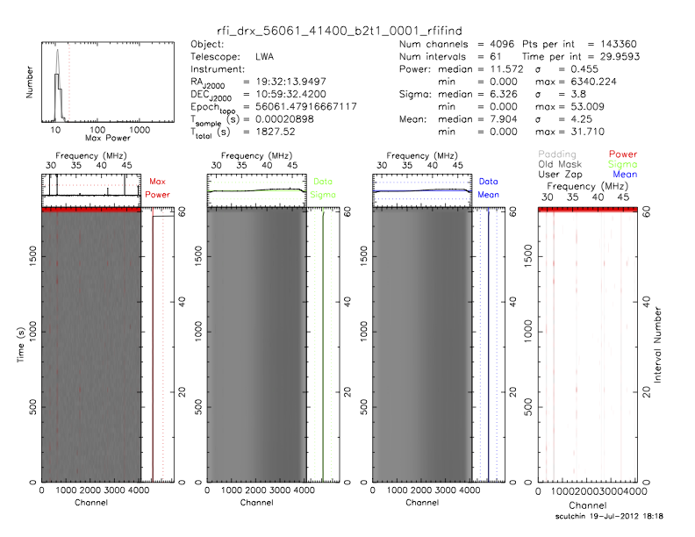

Slide 12
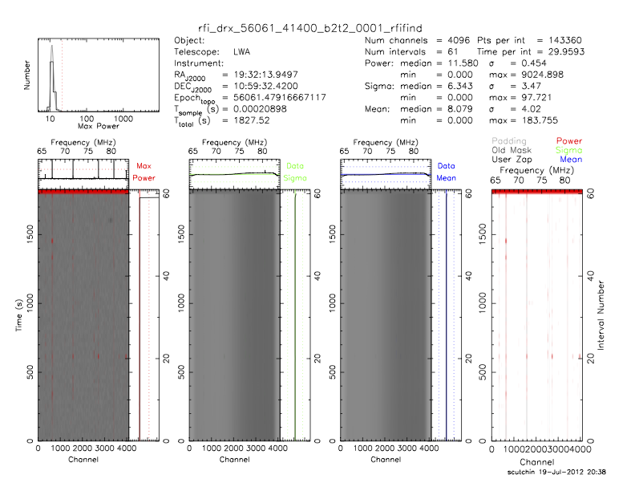

Slide 13
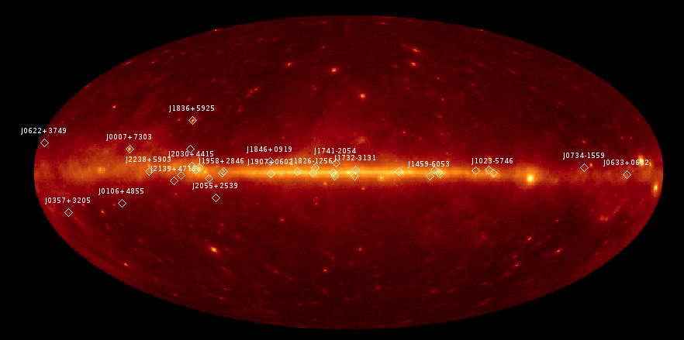
Steep Spectrum Pulsars and Connection to Fermi
Before 2008, Geminga was the only known radio-quiet gamma-ray pulsar
Blind searches of Fermi LAT data have discovered over 36 pulsars in the gamma-ray band
So far, only 4 have been found to pulse in radio, despite very deep searches
Is this a beaming effect or some other physical mechanism?
Low frequency searches are promising because beaming fractions appear to increase
Some pulsars appear to be very steep spectrum
(S ~ ν^{–4})

Slide 14
Fermi Blind Search Pulsars
Long data sets make traditional FFT searches extremely computationally expensive
Difference search algorithm (Atwood et al. 2006) greatly reduces computational requirements
36 blind search pulsars discovered so far
Deeper searches, with sensitivity to isolated MSPs, now running on Einstein@Home

Slide 15
Radio Limits

Slide 16
CFP2 Proposal
Search Geminga and the 30 radio-quiet Fermi blind search pulsars with Decl > –33 and any new discoveries
4 hour DRX observation each with 2 tunings at 38 and 74 MHz
Pulsars are timed with Fermi LAT so analysis only requires folding and a search over DM

Slide 17
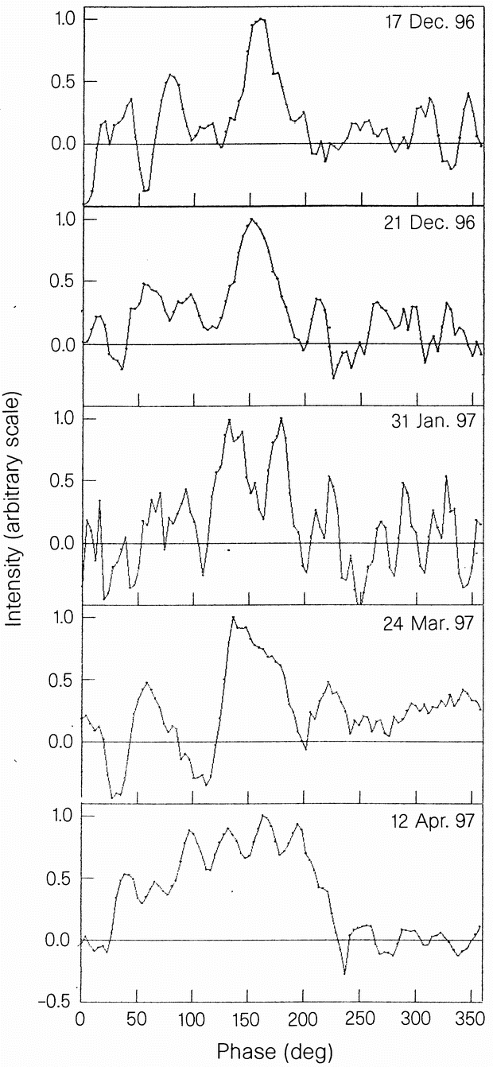
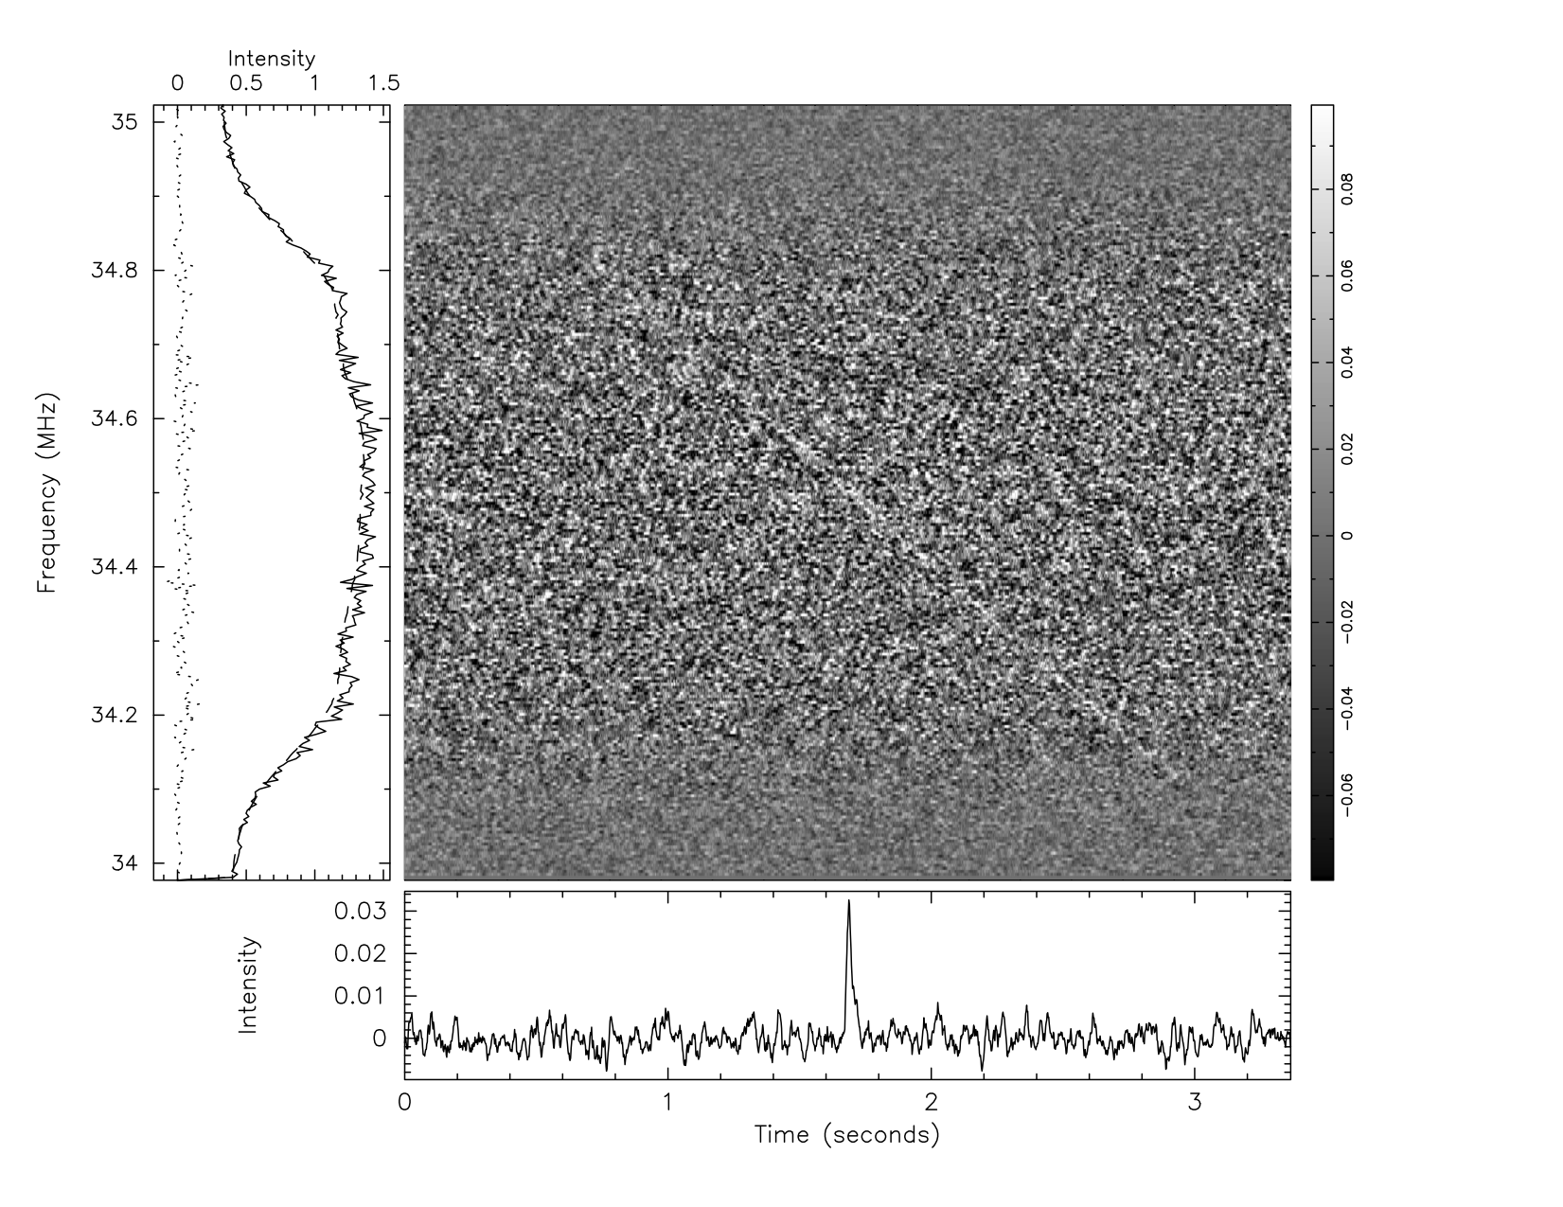
Two Enticing Examples
Geminga
(Pushchino)
Geminga radio pulsations reported at 102.5 MHz (Malofeev & Malov, Nature, 389, 697, 1997)
  Detection remains controversial
Very new report of radio pulsations from Fermi LAT blind search pulsar J1732-3131 at 34.5 MHz using Gauribidanur array in India (arXiv:1109.6032)
LWA1 can confirm or refute these and search for other steep spectrum pulsars, particularly low-luminosity nearby pulsars
PSR J1732-3131
(Gauribidanur)

Slide 18
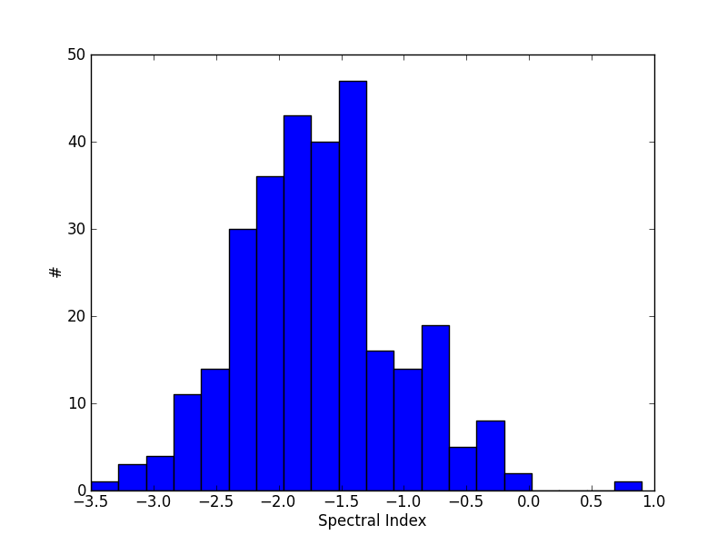
Pulsar Spectral Index Distribution

Slide 19
Observation Summary
Observation summary of what we have in the can so far
Need to keep spreadsheet up to date with observation status and results including clipping percentages
  https://docs.google.com/spreadsheet/ccc?key=0AhWARO__2H7gdFdVWGlFWG43ZGVqcWE2RW5ObTdOd1E
  Soon adding columns for clipping % and analysis status

Slide 20
Next Steps
Start looking at profile evolution vs frequency and dispersion/scattering
Look at spectra across our band (hard; needs flux calibration)
B0950+08 is nice and bright. Analyze for AIPs, and do other single pulse studies
Process all B1133+16 data and demonstrate phase connected timing across many days
Reduce MSP data with coherent dedispersion
Start looking at polarization, esp if we can detect B1929+10

Slide 21
Summary
Lots of good pulsar science to be done with LWA1
Possible exciting results quickly if we detect Geminga or other radio quiet pulsar
Other science requires more instrumental understanding like polarization and flux calibration
Should have timing precision soon
More observations and analysis work needed!
Kevin will describe software and survey plans

