Slide 1
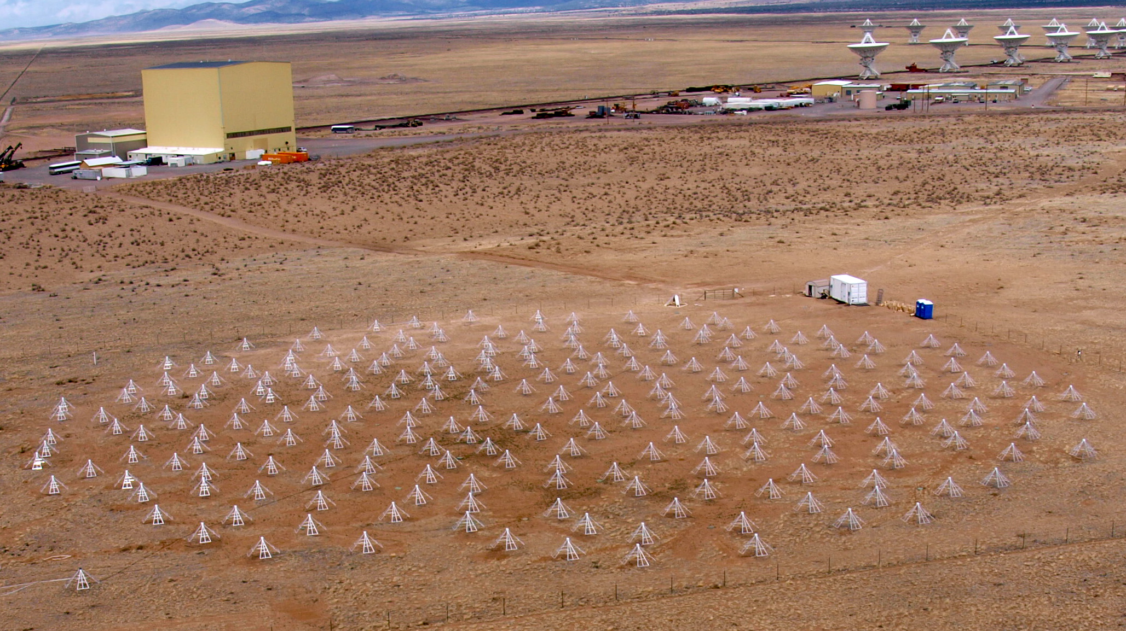
LWA Users Meeting
Greg Taylor (UNM ) on behalf of the LWA Project

Slide 2
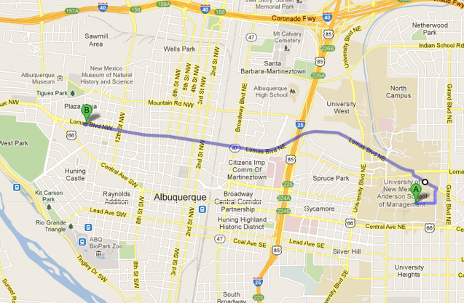
Meeting Logistics
Internet access: see instructions on board
Lunch – at the SUB. Please return by 1:00pm.
Dinner – at Monroe’s, 1520 Lomas Blvd, 6:15pm
NRL by video

Slide 3
LWA1 Status
LWA1 funded as a University Radio Observatory (from 3/1/12)
Initial Operating Capability reached on April 24, 2012
Currently beam forming with 226 stands
All 4 beams operable, though beam 1 tends to underflow
TBN degrades during beamforming, so TBN or beams but not both
See known issues page:
http://www.phys.unm.edu/~lwa/astro/currentissues.html
User forum:
http://lwa1.freeforums.org/index.php
Looking into modifying the HVACs

Slide 4
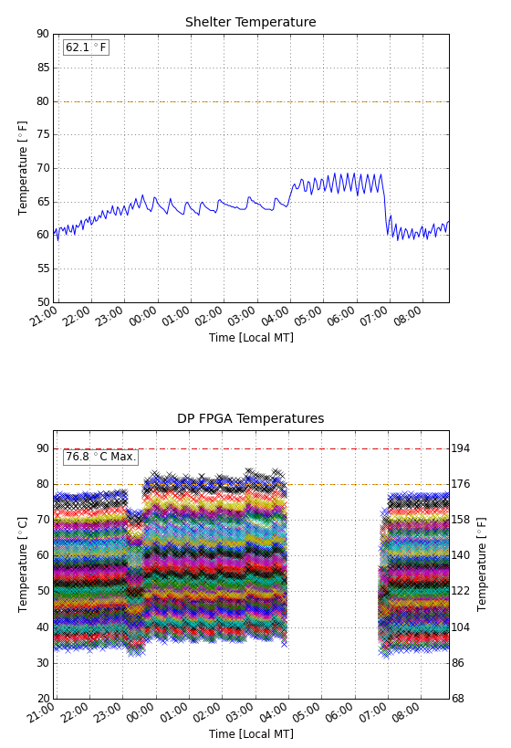
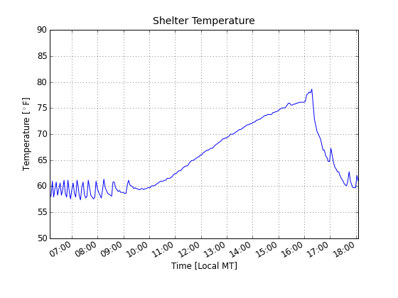
HVAC icing
Severe case
https://lwalab.phys.unm.edu/OpScreen/os.php

Slide 5
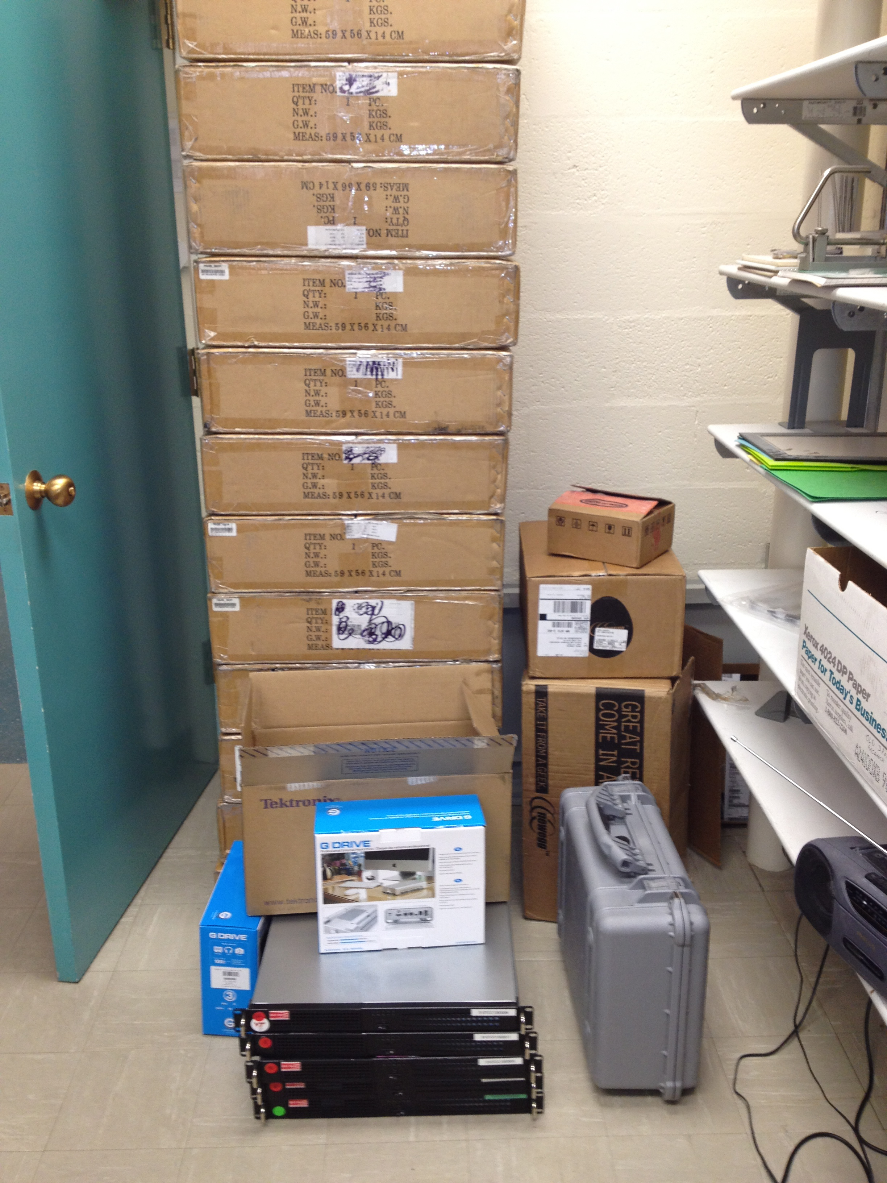
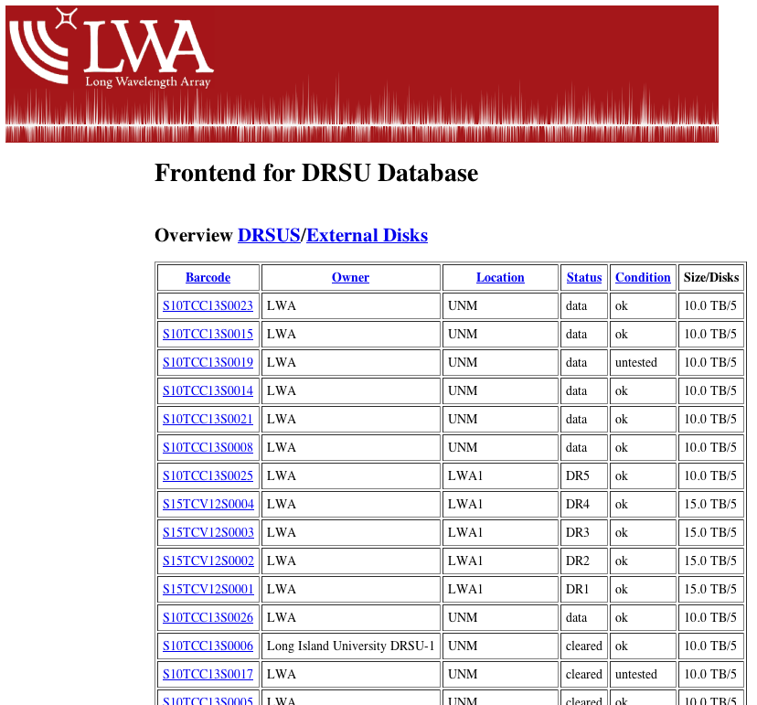
Recording Capability
37 DRSUs (27 UNM + 5 LIU and 5 VT)
mostly 10 or 15 TB capacity each
total DRSU storage 395 TB
At site typically 10 DRSUs = 376 beam hrs + 50 hrs TBW/TBN

Slide 6
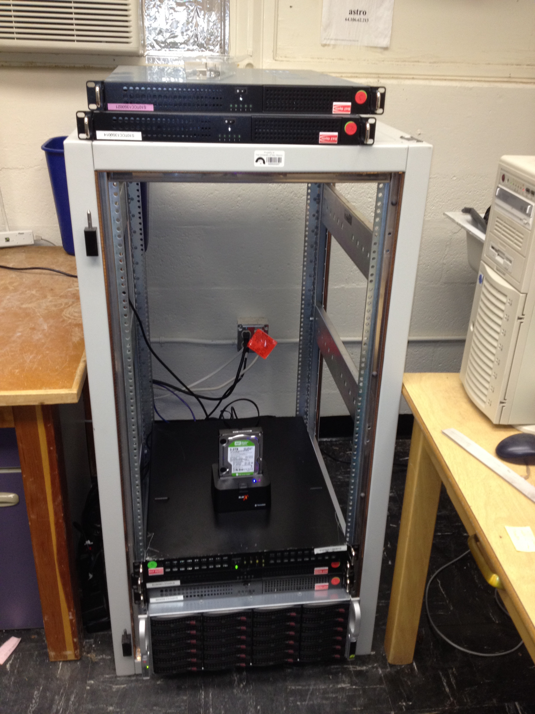
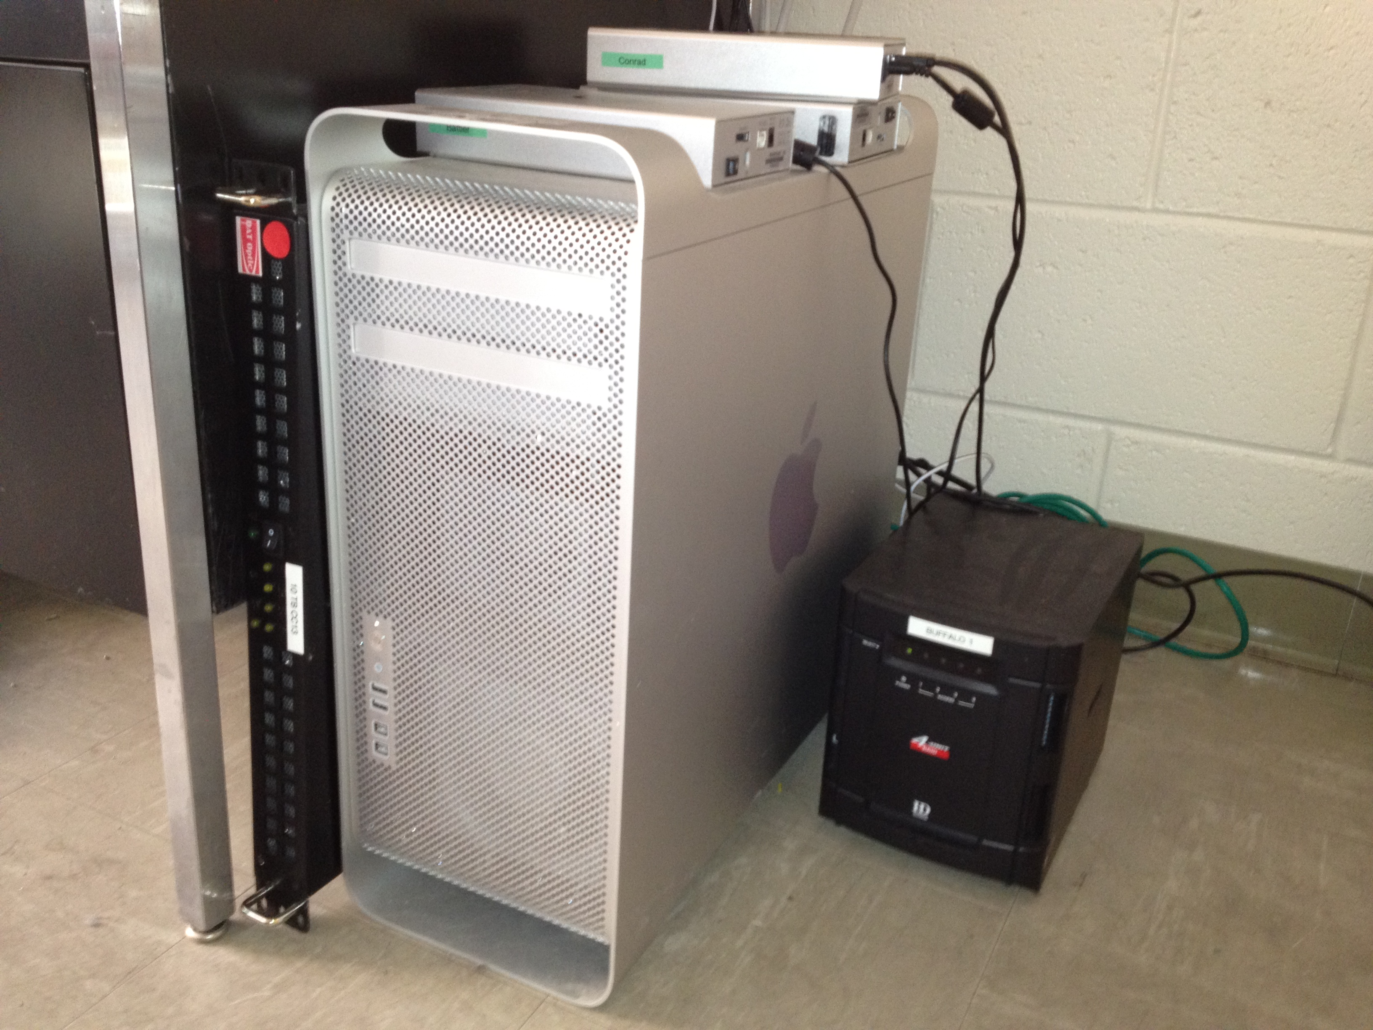
Computing Capabilities
Hercules – dual hexacore Mac Pro with 6 TB storage
Leo – quad core with 48 TB storage
LDA – quad core with 48 TB storage at CARC
new dell dual quad core on order
Leo
Hercules

Slide 7
Current Support
ONR – extended through 9/30/2012
LUNAR program – ends 5/1/2013
Cosmic Dawn program (NSF) – ends 7/31/2013
LEDA (NSF) – ends 8/30/2014
LoFASM (UTB) – ends 1/31/2015
URO (NSF) – ends 2/28/2015
LWA Center at UNM (unrestricted)

Slide 8
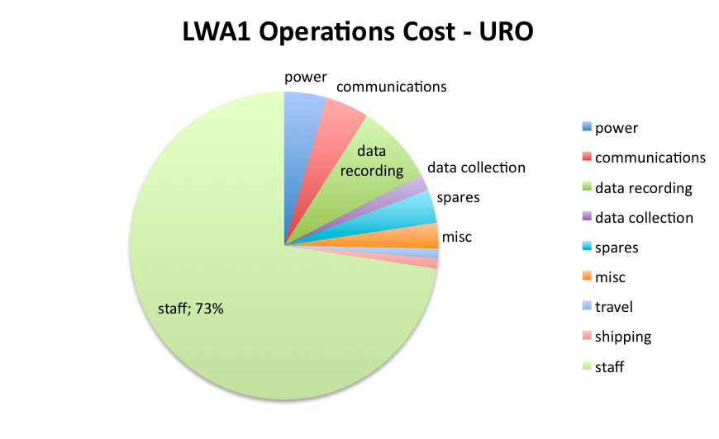
LWA Ops Budget - $600K/year
Notes:
power 26455 communications 27180 data recording 50000 data collection 10011 spares 20939 misc 16000 travel 6192 shipping 6282 staff 432000

Slide 9
Current Staffing

Slide 10
LWA1 Operators
Joe Craig
Jayce Dowell
Steve Ellingson
Jake Hartman
Ken Obenberger
Ylva Pihlstrom
If you want a turn let me know!
Frank Schinzel
Greg Taylor
Hank Tillman
Genevieve Vaive
Chris Wolfe

Slide 11
CFP1 Completion Status
Code Allocated Observed Percent completed PI Project
--------------------------------------------------------------------------------------------
LC001 56 89.4 160 Clarke, Jupiter
LC002 344 236.5 69 Crane, Ionosphere
LE001 320 2.8 0.9 Ellingson, GRB triggers
LE002 640 153.39 24 Ellingson, Crab giant pulses
LH001 6 14.34 239 Hartman/Schinzel, Cas A/Cyg A ratio
LH002 300 429.32 143 Hartman, Hot Jupiters
LK001 580 138 23.8 Kavic, mulit-messenger survey
LP001 378 204 54 Pihlström, RRLs
LP002 672 9 1 Polisensky, survey
LR001 50 69.5 139 Ray, pulsars
LS001 320 197.2 59.1 Simonetti, dispersed pulses
LW001 320 41 12.8 White, solar
Total number of DRX beam hrs in CFP1: 3966
Percentage completed: 40% (1585 hrs)
Notes:
approaching half a petabyte

Slide 12
Programmatic Commitments
Code Allocated Observed Percent completed PI Project
--------------------------------------------------------------------------------------------
LB002 520 24 4.6 Bowman, Cosmic Dawn Clarke,
LG001 300 0 0 Greenhill, LEDA
Total number of DRX beam hrs in PC: 820
Percentage completed: 3% (24 hrs)

Slide 13
LWA Publications in 2012
The LWA1 Radio Telescope, S.W. Ellingson, IEEE, 2012, submitted
First Light for the First Station of the the Long Wavelength Array, G.B. Taylor et al., JAI, 2012, in press
The Long Wavelength Array Software Library, J. Dowell et al. 2012, JAI, submitted
Probing the Climatological Impact of a Cosmic Ray-Cloud Connection through Low-Frequency Radio Observations, Magee & Kavic, 2012

Slide 14
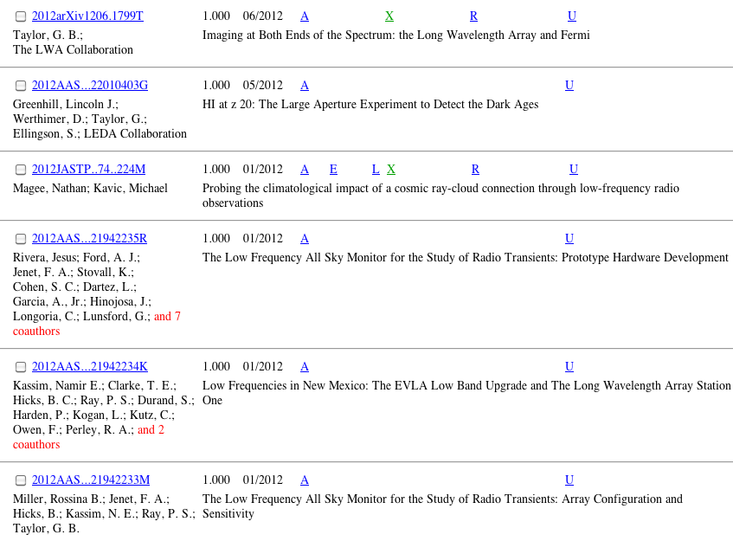
LWA Proceedings in 2012

Slide 15
Publication Policy
Opt-in policy is in effect (see publication policy!)
First author posts draft for two week “sign-up”
First author decides order of authorship
acknowledgements: “Construction of the LWA has been supported by the Office of Naval Research under Contract N00014-07-C-0147. Support for operations and continuing development of the LWA1 is provided by the National Science Foundation under grant AST-1139974 of the University Radio Observatory program."

Slide 16
Goals
Review LWA1 Hardware and current capabilities
Learn How to Use LWA1
Preliminary results with LWA1
New Instrumentation
Inform you about many related projects & proposals
Exchange ideas
Gather fodder for URO reporting

Slide 17
Backup Slides

Slide 18
Technical Specifications:
Required Achieved
Frequency Range: 20 MHz to 80 MHz 10 MHz to 88 MHz
Angular resolution: θ ≤ [8,2]” θ ≤ [7,1.4]”
LAS at [20,80] MHz ≥ [8,2]° ≥ [16,4]°
Baseline range: 100 m to 400 km 50 m to 600 km
Sensitivity [20,80 MHz]: σ ≤ [1.0,0.5] σ ≤ [0.5,0.1]
Collecting Area (m²) A_{e}= 1 x 10⁶ A_{e}= 4x10⁶
Dynamic range: DR ≥ [1x10³,2x10³] DR≥ [2x10³, 8x10³]
Δν_{max} (per beam) Δν ≥ 4 MHz Δν = 20 MHz
Δν_{min} Δν ≤ 100 Hz Δν ≤ 10 Hz
Temporal Res Δτ = 10 msec Δτ ≤ 0.1 msec
Polarization: 1 circular Full
Sky Coverage: z ≥ 40° z ≥ 15°
FoV [20,80] MHz [8,2]° ≤ [16,4]°
# of beams: 4 single pol. 4 single pol.
Configuration: 2D array, N = 53 stations 2D array, N≥53

